Slide 1
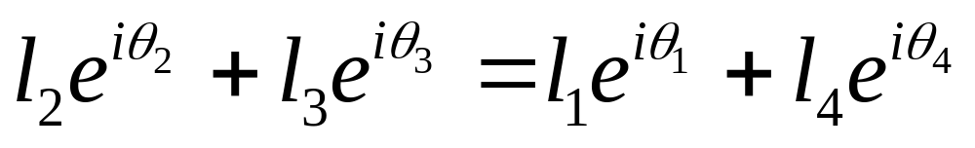
Limit Position Analysis of a 4 Bar Crank Rocker RRRR Linkage Using Complex Numbers
P
Im
l₃
l₄
Q
l₅
θ₅
θ₄
θ₃
l₂
θ₂
l₁
θ₁
Re
O
Viewing the point P from two directions in the complex plane

Slide 2
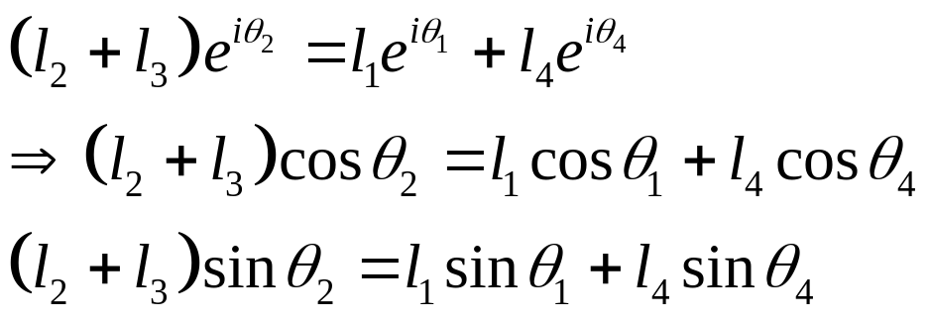
Limit Position Analysis of a 4 Bar Crank Rocker RRRR Linkage Using Complex Numbers
One extreme position
P
Im
l₃
l₄
Q
l₅
θ₅
θ₃ =θ₂
θ₄
l₂
θ₂
l₁
θ₁
Re
O

Slide 3
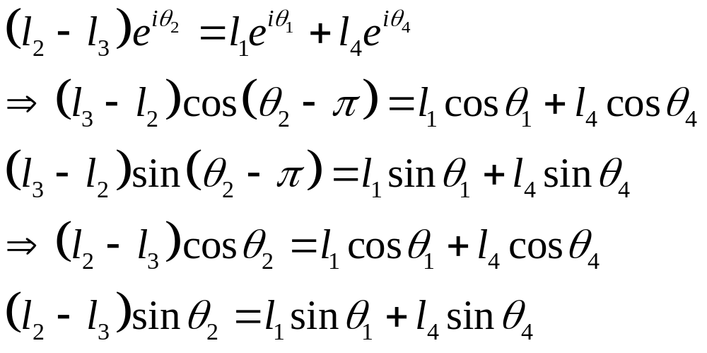
Limit Position Analysis of a 4 Bar Crank Rocker RRRR Linkage Using Complex Numbers
Another extreme position
Im
θ₃=θ₂-π
l₄
θ₄
P
Q
l₃
θ₂
l₁
θ₁
Re
l₅
θ₅
O
l₂

Slide 4
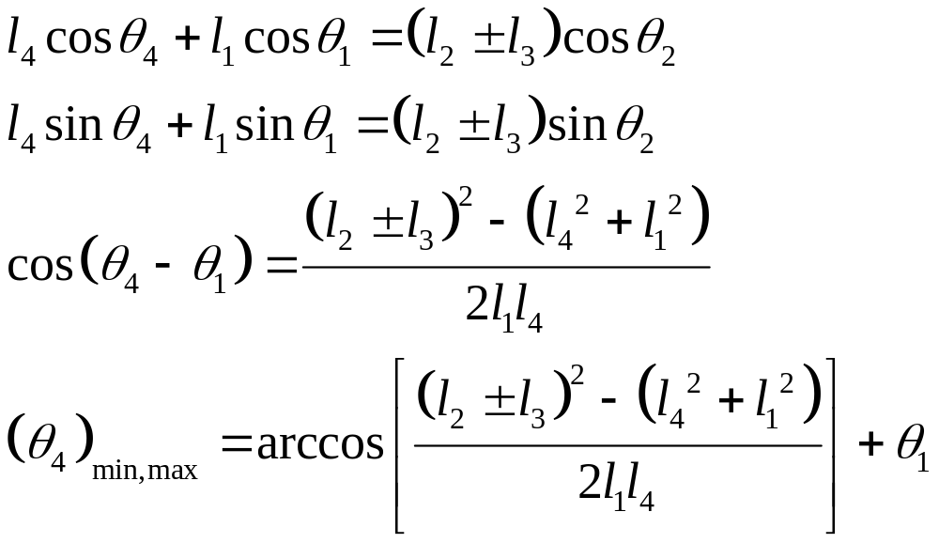
Limit Position Analysis of a 4 Bar Crank Rocker RRRR Linkage Using Complex Numbers
In general
Im
θ₃=θ₂-π
l₄
θ₄
P
Q
l₃
θ₂
l₁
θ₁
Re
l₅
θ₅
O
l₂

Slide 5
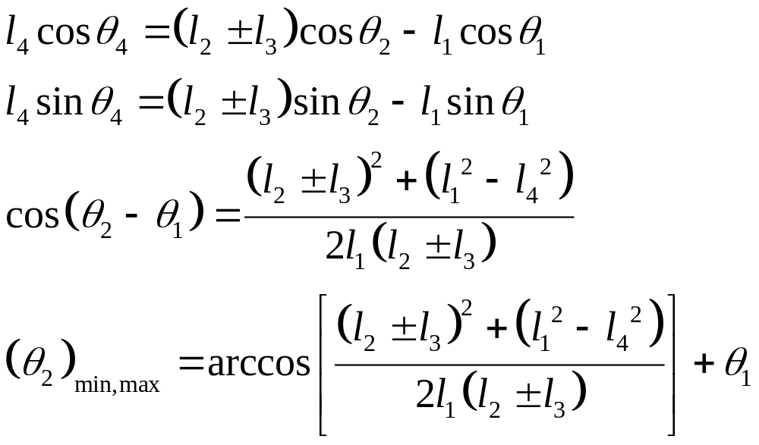
Limit Position Analysis of a 4 Bar Crank Rocker RRRR Linkage Using Complex Numbers
In general
Im
θ₃=θ₂-π
l₄
θ₄
P
Q
l₃
θ₂
l₁
θ₁
Re
l₅
θ₅
O
l₂

